Slide 1
The Rhythm of the Economy
Witold de La Chapelle

Slide 2
Summary
Definitions of rhythm
Can GDP be considered a rhythm?
Methodology: the how?
Methodology: the why?
Significance of the study
Next steps
Let’s try it out!

Slide 3
Definitions of rhythm
Perceived as a notion pertaining solely to the field of music
Only 43% of rhythm definitions bind it to music
Didymus: A schematic arrangement of sounds
R. Parncutt: Acoustic sequence evoking a sensation of pulse
S. Arom: For there to be rhythm, sequences of audible events must be characterized by contrasting features.

Slide 4
Definitions of rhythms
The remaining definitions ( 57%) assign the notion of rhyhtm to a much broader scope
Phaedrus: Some measured thesis of syllables, placed together in certain ways.
M. Clayton: Rhythm, then may be either interpreted as an alternation of stresses or as a succession of durations
Plato’s: Rhythm is an order of movement

Slide 5
Can GDP be considered a rhythm?
1. Movement: GDP values move over time ✔
2. Order: Are they truly ordered?

Slide 6
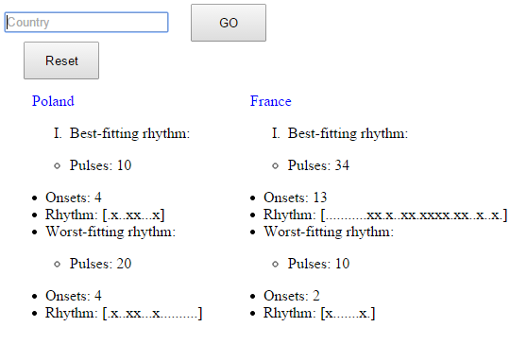
Form of the study
The result of the study is a web application

Slide 7
The how: Methodology
Data gathered from the World Bank for the years 1961-2013
For each year, GDP change calculated.

Slide 8
Methodology
Number of years for which data from the World Bank is valid is divided by the number of pulses into a whole number of cycles
The mean values for the corresponding GDP growth values in each cycle are calculated and a new list of mean values is created

Slide 9
Methodology
The mean and standard value of the list are calculated.
Values inside mean +- standard deviation are assigned a dot (silent pulse)
Values outside that interval are assigned x (onset)

Slide 10
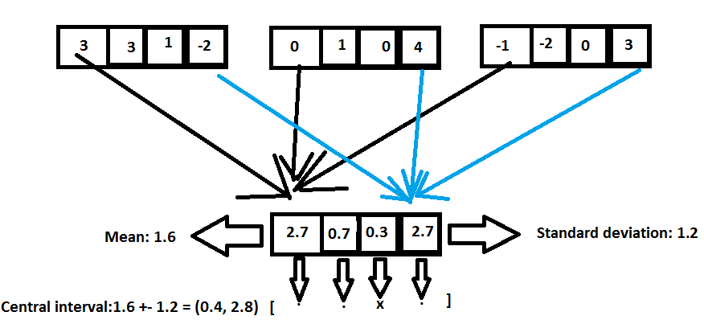
Methodology

Slide 11
Methodology
The application will try to generate rhythms with number of pulses from 4 to 32 and then display the best and worst rhythms

Slide 12
Methodology
How are best and worst rhythms determined?
Accuracy = mean_difference1/mean_difference2

Slide 13
Methodology
The mean_difference 1 is the mean difference between the GDP growth values and the mean for onsets
The greater it is, the more these pulses can be considered onsets
The mean_difference 1 is the mean difference between the GDP growth values and the mean for silent pulses
The smaller it is, the more these pulses can be considered silentpulses

Slide 14
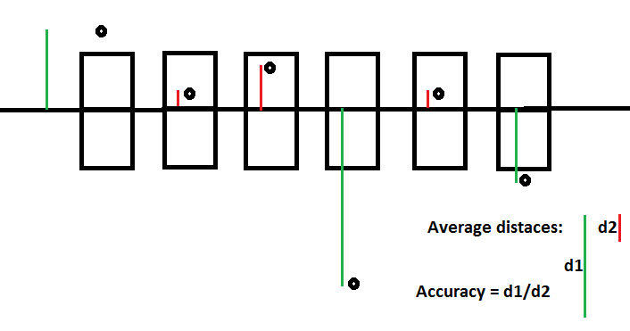
Methodology

Slide 15
The why: Methodology
How to detect patterns in growth values?
Analyze corresponding pulses →subdivide data into cycles
Generalize about each pulse→ calculate mean of corresponding values and create a new array of means
Determine whether pulse is an onset or a silent pulse → How?
What differentiates an onset from a silent pulse?

Slide 16
What differentiates an onset from a silent pulse?
Let’s assign an arbitrary value of 1 to an onset and 0 to a silent pulse (mirroring the fact that an onset generates a given number of decibels, whereas a silent pulse doesn’t generate any).
Clave son:
[1001001000101000]
Total: 1+0+0+1+0+0+1+0+0+0+1+0+1+0+0+0=5
Average = 5/16=0.31
0, that is, a silent pulse, is closer to 0.31 than 1, an onset.
Hence onsets are wider spread than silent pulses.

Slide 17

Measure of spread: Standard deviation
The greater the value of the standard deviation, the greater the spread of data.

Slide 18
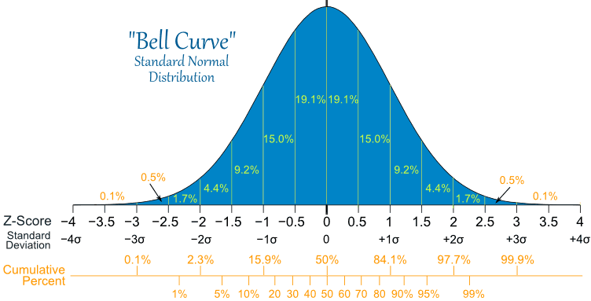
Measure of spread: Standard deviation

Slide 19
Measure of spread: Standard deviation
Fact: The interval (mean- standard deviation, mean + standard deviation )contains 68.3% of all data.
Most commonly studied rhythms in class have 16 pulses
68.3% of 16 is equal to 10.92≈11
16-11 = 5
For 16 pulses – rhythms, the most common number of onsets is 5.

Slide 20
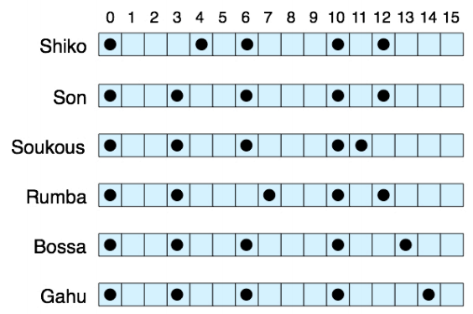
Rhythms with 16 pulses and 5 onsets

Slide 21
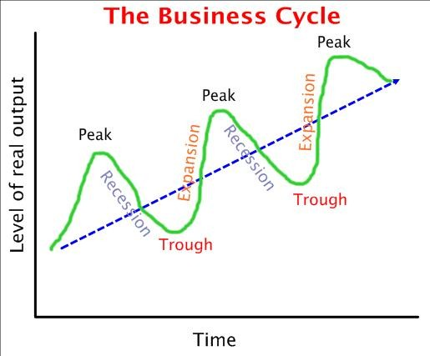
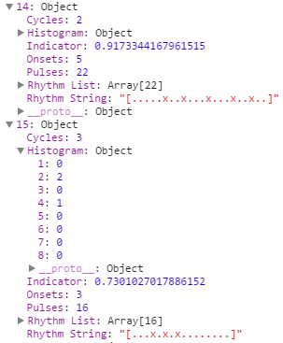
Significance
Attempt to quantify economic rhythms
vs

Slide 22
Significance
If we can prove that GDP can be considered a rhythm then we can apply the rich knowledge about musical rhythms to economic rhythms
Off-beatness
Oddity
Measures of syncopation
Edit distances
Deepness
Web application form allows for constant research

Slide 23
Next Steps
Addition of various economic indices
In-depth analysis of generated rhythms to reach a conclusion
Can GDP really be considered in terms of musical rhythms?

Slide 24
Let’s try the application!
Link:
http://wit221.github.io/Rhythm-of-Economics/

Slide 25
Thank you for your attention

